Slide 1

CAPSTONE POWER BI PROJECT TECHTRONIX A hi-tech case study
Sunday Adams Omale

Slide 2

Analysis Goals
Problem Statement Techtronix Innovations, a leader in the microchip and robotics industry, is currently facing significant challenges in optimizing its sales strategies, refining production planning, and expanding into new markets. These issues stem from unpredictable demand, inefficiencies in inventory management, and difficulties in identifying profitable market opportunities. The company needs a comprehensive analysis to address these pain points and unlock growth potential.
Goals
Build a Power BI report to analyze sales performance, customer insights, inventory optimization, profitability, and identify market expansion opportunities.

Slide 3
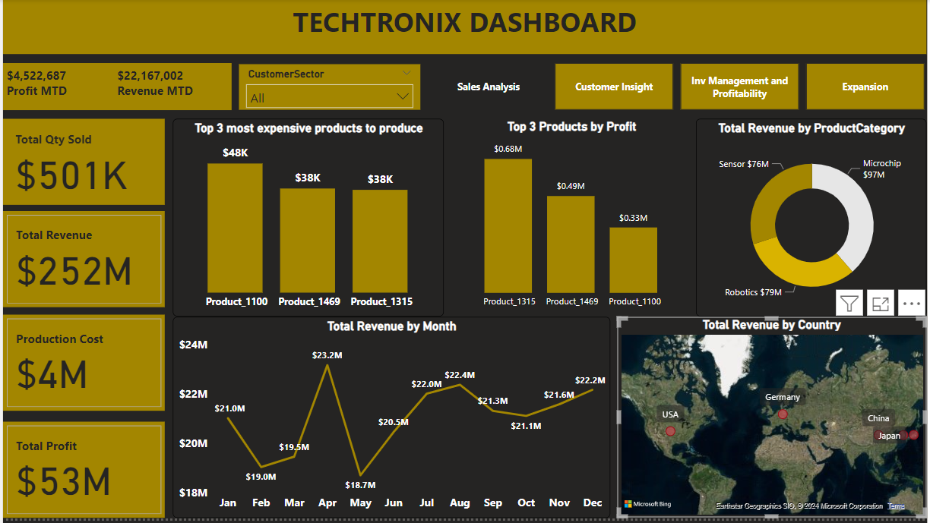
SALES ANALYSIS DASHBOARD

Slide 4
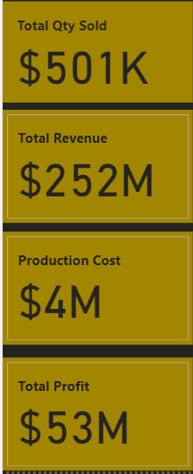
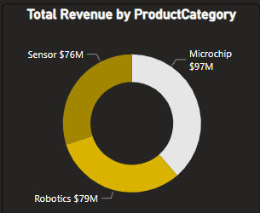
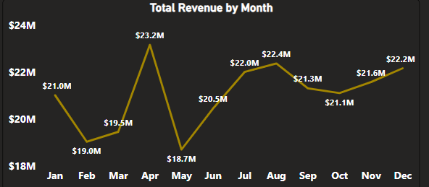
Sales Performance Analysis
From the revenue trend analysis by month, it is very clear that the peak sales was achieved in April, and it slumped in May.
Microchip leads in product performance and sensor lags in product performance as shown in the total revenue by month graph.

Slide 5
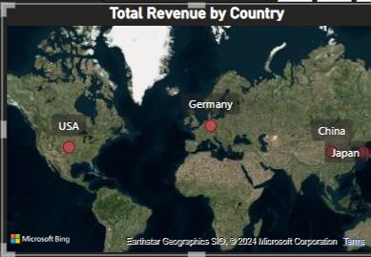
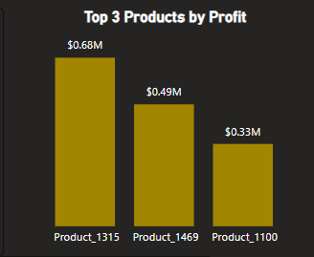
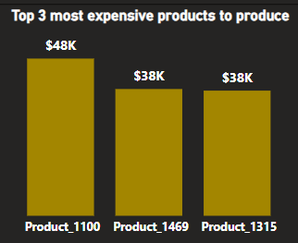
Sales Performance Analysis
Within the regions sales performed better in USA, Germany and China and Japan.
The three top performing product with the highest profit is shown in the graph.
The three most expensive products to produce is shown in the graph.

Slide 6
Sales Performance Analysis
Insight:
Microchips are the best-performing product category in the automotive sector, especially in North America, showing consistent growth.
Robotics products have seen a decline in sales, particularly in the consumer electronics sector.
Recommendations:
Increase production and marketing efforts for microchips, particularly in North America. Consider expanding similar efforts in Europe and Asia.
Conduct a detailed review of the robotics product line in the consumer electronics sector. Consider product redesign, marketing refresh, or exploring new customer segments.

Slide 7
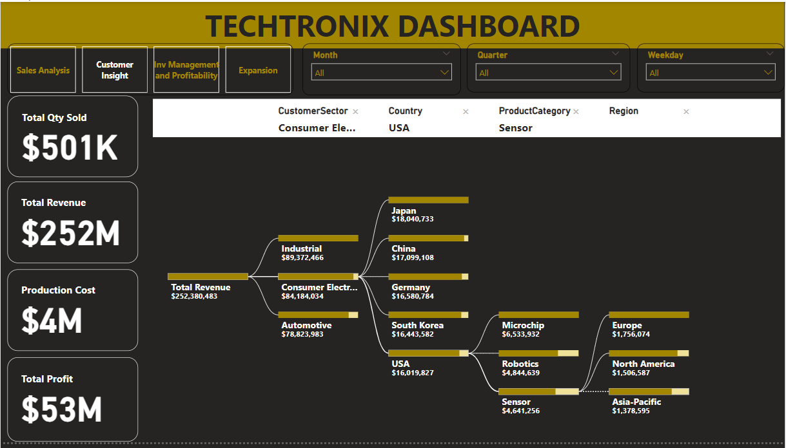
CUSTOMER INSIGHT DASHBOARD

Slide 8
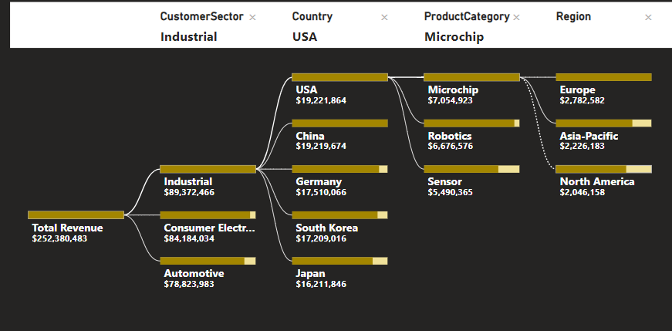
Customer Insight Analysis
In the industrial sector, customers in USA contributed the highest revenue through microchips.

Slide 9
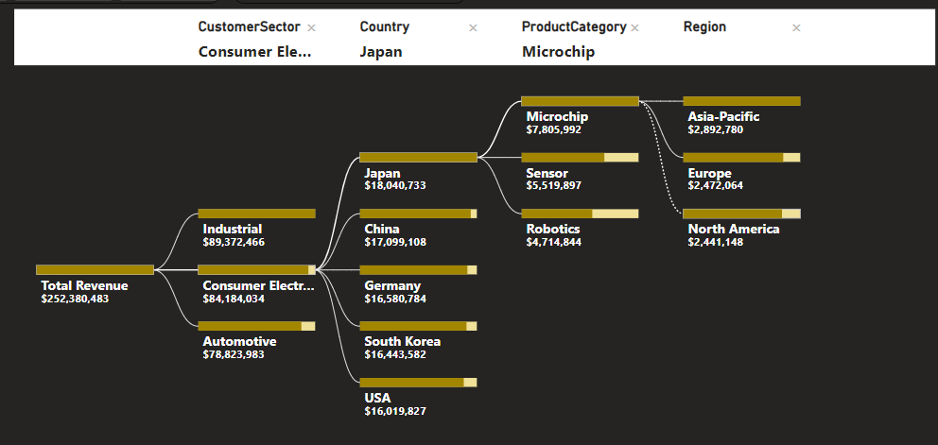
Customer Insight Analysis
In the consumer electronic sector, customers in Japan contributed the highest revenue through microchips.

Slide 10
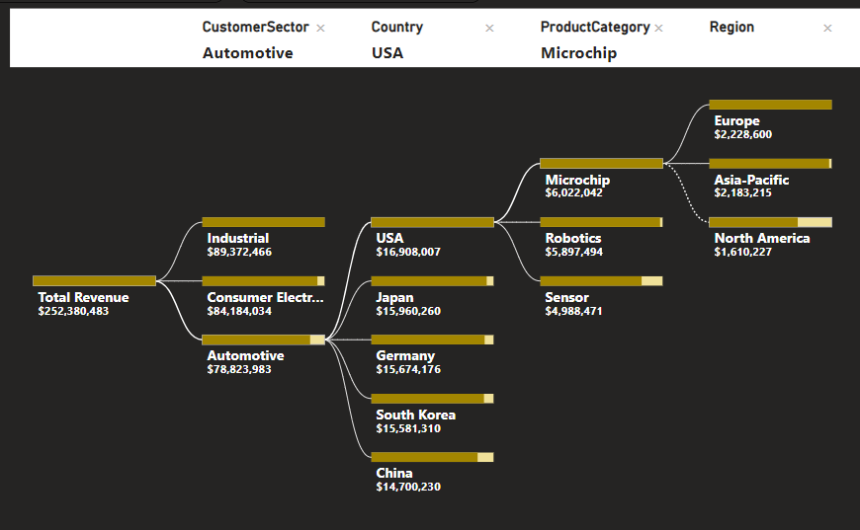
Customer Insight Analysis
In the automobile sector sales of microchips generated more revenue with the highest sales in USA.

Slide 11
Customer Insight Analysis
Insight:
The industrial sector customers contribute the highest average revenue per transaction but show declining repeat purchases.
Geographic analysis reveals that Asia, particularly in the industrial sector, is an under-tapped market.
Recommendations:
Implement targeted customer retention programs for industrial sector clients, including loyalty discounts, personalized marketing, and enhanced post-purchase.
Increase sales efforts in the Asian market, leveraging localized marketing and partnerships with regional distributors.

Slide 12
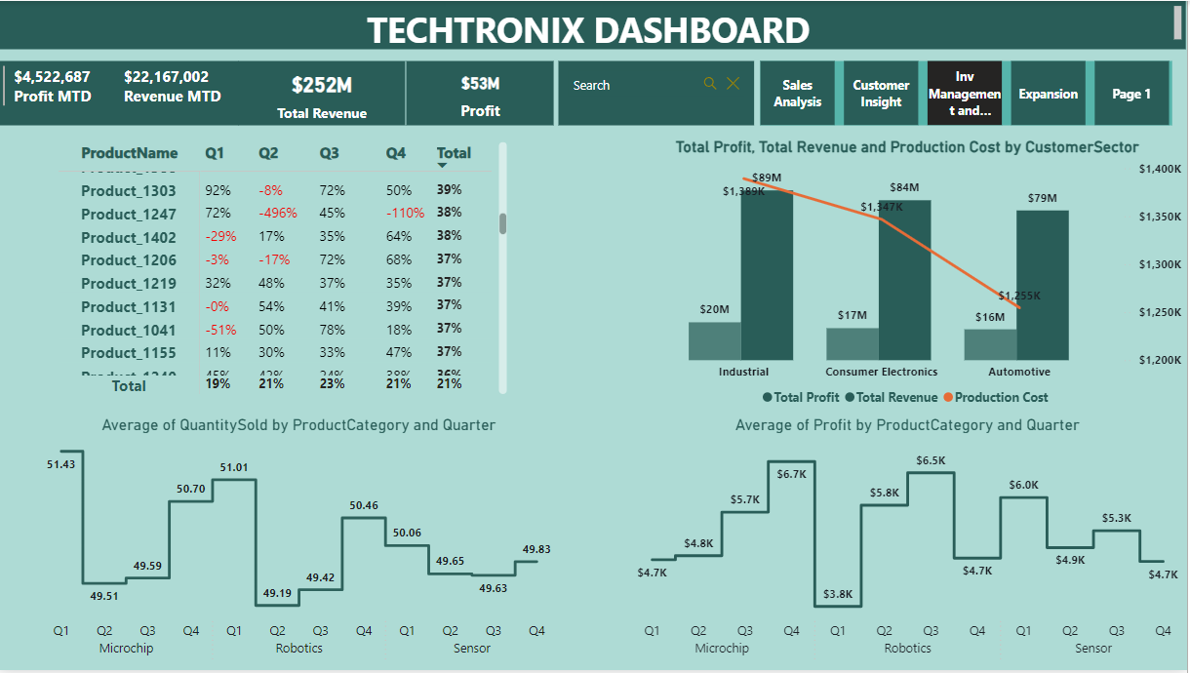
INVENTORY MGT & PROFITABILITY DASHBOARD

Slide 13
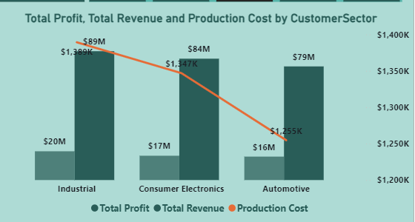
Inventory Mgt & Profitability Analysis
In industrial sector, the production cost is a very high compared to the production cost of other sectors, however the revenue generated is higher than other sectors as well giving a higher profit compared to other sectors.

Slide 14
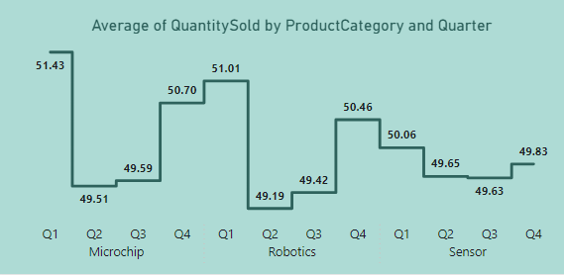
Inventory Mgt & Profitability Analysis
In Q1 the quantity of microchips sold was higher than every other quarter, however we noticed a sharp decline in Q2 and picked up again.
Robotics and Sensor sold less compared to microchip, even though they got highest sales in Q4.

Slide 15
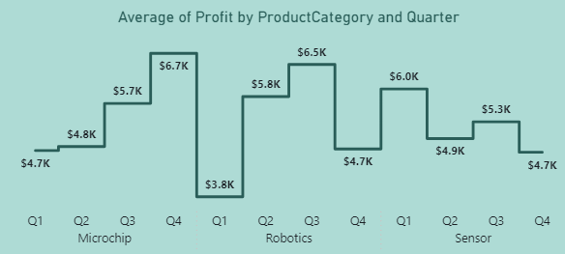
Inventory Mgt & Profitability Analysis
Even though microchips sold more in Q1, the average profit was in Q4. It is possible that more expensive microchips were sold in Q4.
Robotics had the highest average profit in Q3 while sensor had highest average profit in Q1.

Slide 16
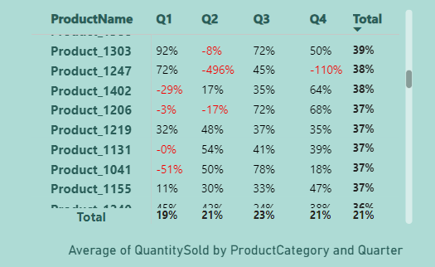
Inventory Mgt & Profitability Analysis
From the chart, it is clear some products are fast moving while some are slow moving in some quarter.
Items that were redundant in a particular quarter are captured in red font color.

Slide 17
Inventory Mgt & Profitability Analysis
Insight:
There is a consistent overproduction of robotics in the consumer electronics sector, leading to high inventory holding costs and increased risk of obsolescence.
The sensor category, particularly in the automotive sector, has the highest profit margins but is currently under-marketed.
Recommendations:
Adjust production schedules based on demand forecasting models, reducing overproduction and aligning inventory levels more closely with actual market demand.
Focus on promoting sensors in the automotive sector through targeted marketing campaigns and expanding the sales team to increase market penetration.

Slide 18
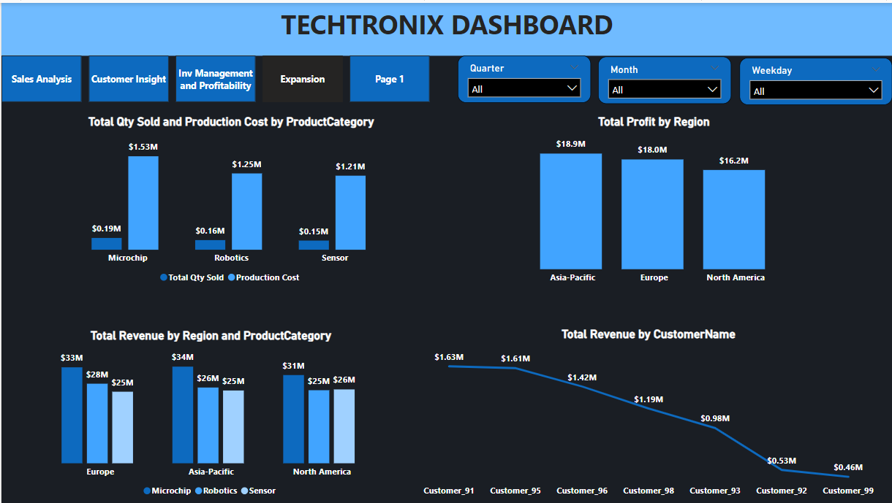
EXPANSION DASHBOARD

Slide 19
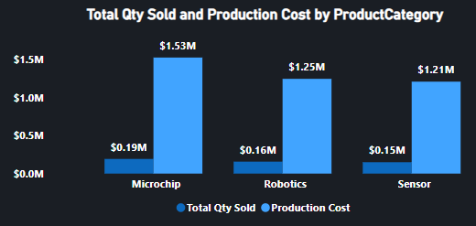
Expansion Analysis
Despite decent sales, robotics and sensors show lower revenue compared to microchips, with production costs close to those of microchips.

Slide 20
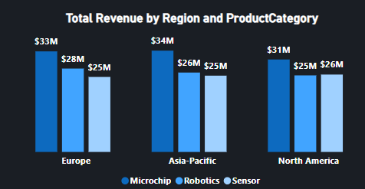
Expansion Analysis
Asia-Pacific has shown the highest profitability and revenue for microchips, which is the most significant product for all category.
Europe has the second-highest revenue and profit margins, with robotics contributing significantly. The demand for robotics in the industrial and consumer electronics sectors is strong.
North America, while profitable, shows lower growth potential compared to Asia-Pacific and Europe. However, the steady demand across all product categories presents an opportunity for consolidation and steady growth.

Slide 21
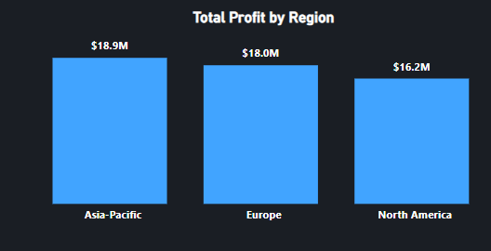
Expansion Analysis
Asia-Pacific has shown the highest profit. Tailor marketing strategies to the specific needs and preferences of the Asia-Pacific market, focusing on the strengths of microchips.
Since Europe has shown the second highest profit margin. Develop customized solutions tailored to the unique needs of the European market, particularly in the industrial automation and consumer electronics.

Slide 22
Expansion Analysis
Recommendations:
Strengthen partnerships with local companies to enhance market penetration, particularly in sectors showing high demand for robotics and sensors.
Consider outsourcing certain stages of the microchip production process to regions with lower manufacturing costs, like Asia-Pacific, where there is already significant demand.
Launch targeted campaigns to increase awareness and adoption of robotics in new sectors within Europe, such as healthcare and renewable energy.
Implement loyalty programs for existing customers to enhance repeat purchases and maintain steady revenue growth, particularly in the automotive sector.

Slide 23
Expansion Analysis
Recommendations:
Invest in R&D to innovate within the robotics and sensor product lines, focusing on high-growth industries such as IoT and AI-driven automation.
Conduct in-depth market research to identify specific needs and explore untapped emerging market such as Africa and Latin America that present opportunities for growth.
Consider joint ventures or partnerships with local firms to enter these markets with a strong foothold, focusing initially on sensors and microchips due to their broader applicability.

Slide 24
Conclusion
By combining regional focus, product specialization, and customer segmentation, and implementing these insights and recommendations, Techtronix Innovations can;
Enhance its sales strategies
Optimize production planning
Improve inventory management
And successfully expand into new markets.
This approach will lead to improved profitability, better market positioning, and sustained growth in the competitive microchip and robotics industry.

Slide 25
Thank You

